Slide 1
Microsoft Excel
Crash Course
Created by Ali Abbiss
Image quality may be reduced if viewed in a web-browser

Slide 2
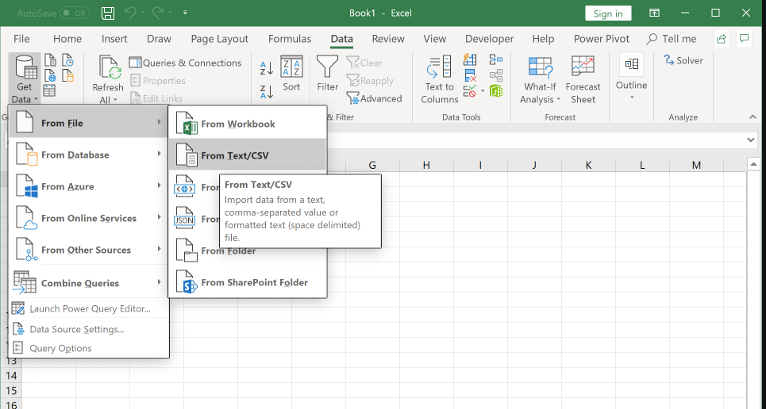
Importing Data From Text (.txt/csv) Files
To import data into Excel from a .txt/.csv file, go to the Data tab on the ribbon, in the Get and Transform Data group, select Get Data > From File > From Text/CSV.
Locate and select the file you wish to open, then the Import Settings box opens. If you wish to import data to an existing or current worksheet, select Load To > Existing Worksheet.

Slide 3
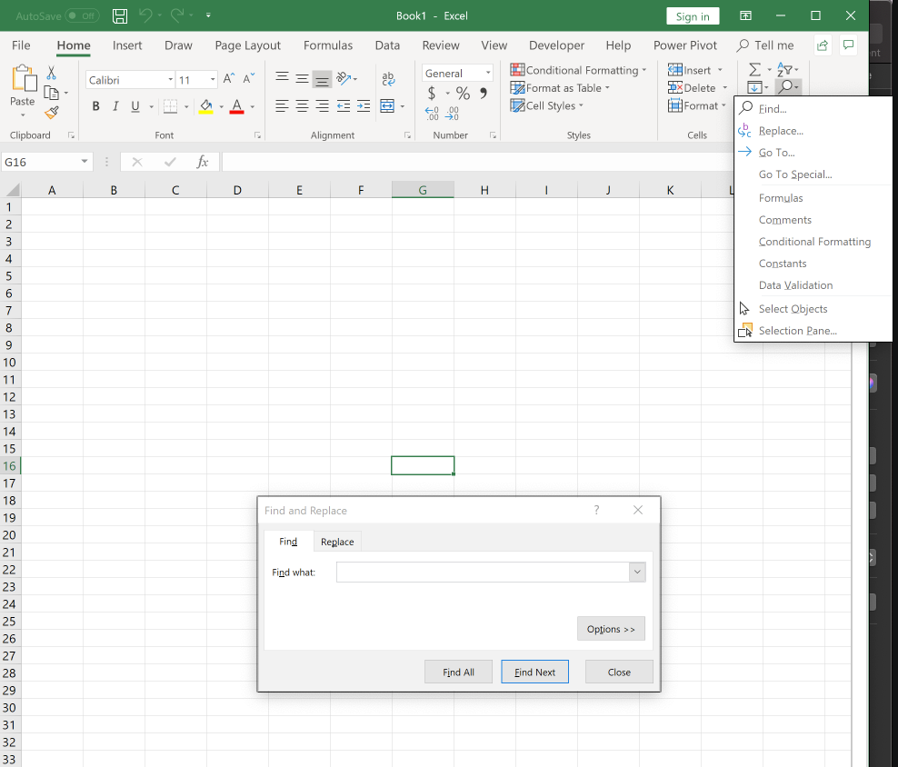
Navigating Excel
To search for data in a workbook, press Ctrl+f, or go to the Home tab and select the magnifying glass in the Editing group.
To navigate to a named cell, range, or cell element, press Ctrl-g. The Go-To box opens. Enter a reference you wish to find in the workbook.

Slide 4
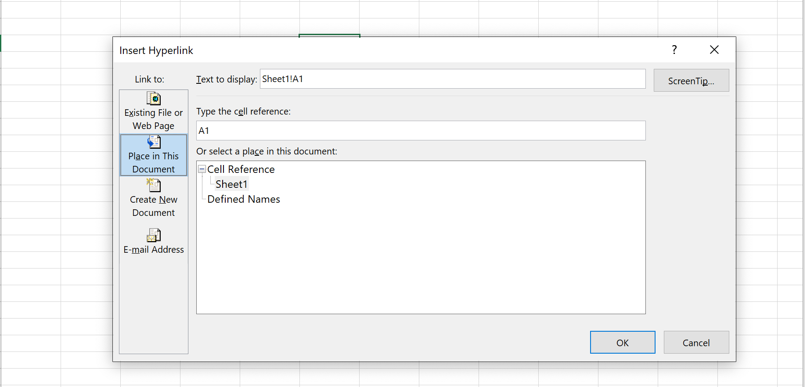
Inserting & Removing Hyperlinks
To insert a Hyperlink into Excel, click the cell, object, or other cell element you want to add the link to. On the Insert tab, in the Links group, select Hyperlink.
You can also press Ctrl-k.
To remove a Hyperlink without deleting its associated element, right-click the Hyperlink, and click Remove Hyperlink on the shortcut menu.
To Delete a Hyperlink and its associated element, right click the cell containing the Hyperlink, then press Clear Contents on the shortcut menu.

Slide 5
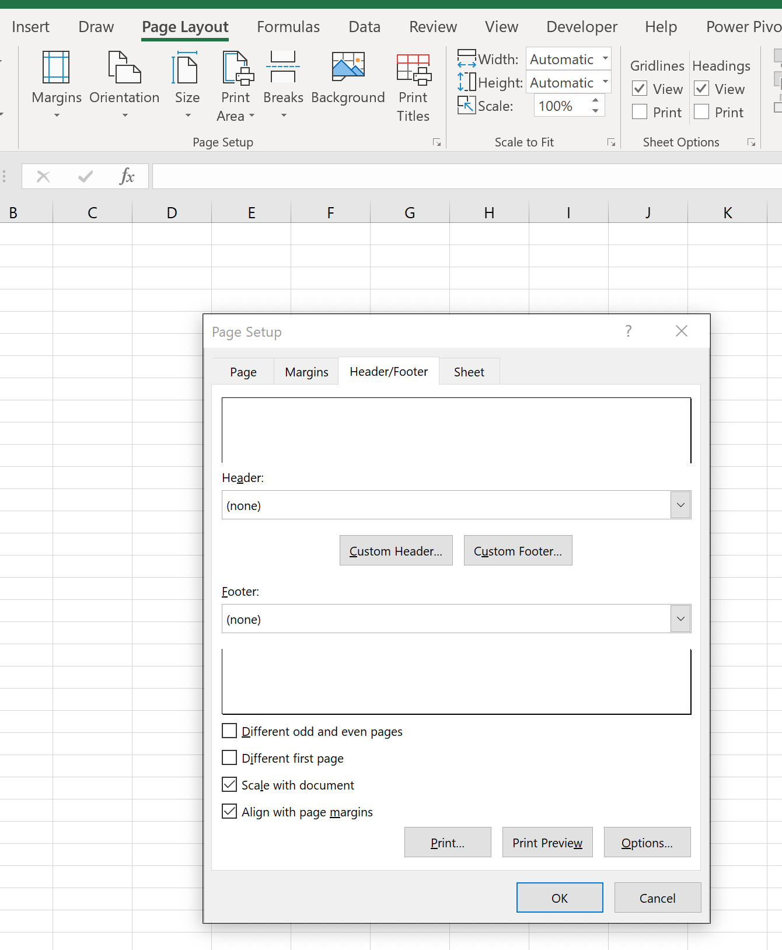
Formatting Worksheets
On the Page Layout tab, select the small Page Setup icon in the bottom-right corner of the Page Setup group.
The Page Setup options box opens, showing tabs for customizing the worksheet. To customize the headers and footers, go to the Header/Footer tab in the Page Setup options box.

Slide 6
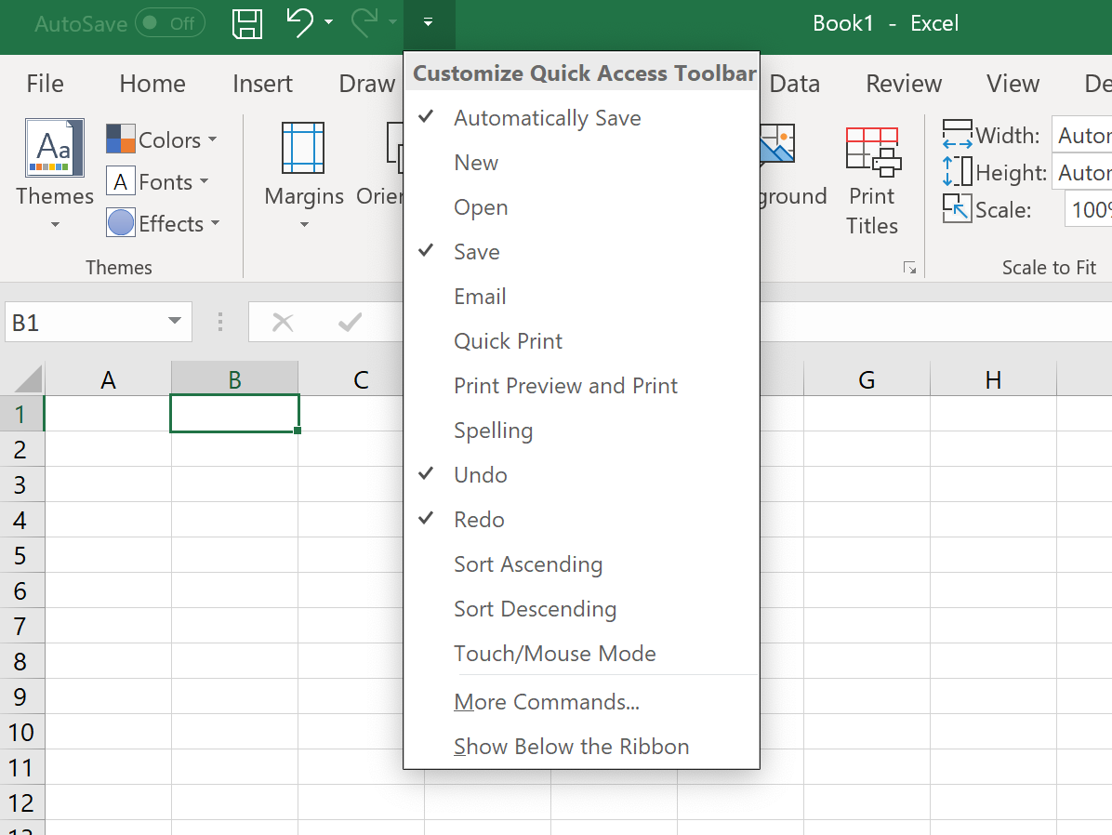
Customizing Excel
To customize the Quick Access toolbar, simply select the small icon next to the Re-do button.

Slide 7
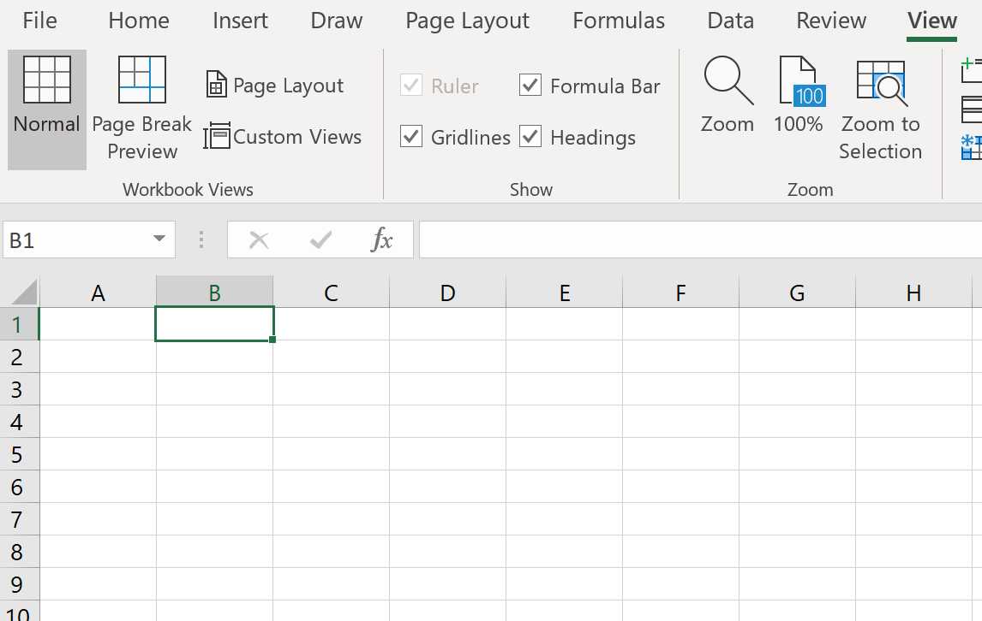
Customizing Excel
To display and modify workbook content in different views, go to the View tab, and view the options in the Workbook Views group. You can change the view style of the workbook, or customize one yourself.

Slide 8
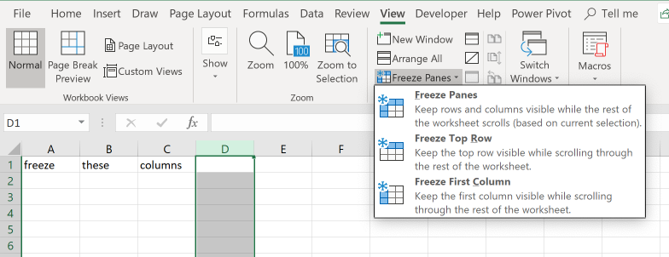
Customizing Excel
To freeze and unfreeze rows and columns in a worksheet, in the View tab, in the Window group, and select which option you’d like to use in the Freeze Panes tab.

Slide 9
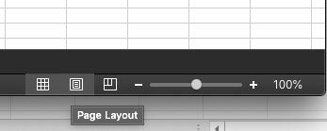
Customizing Excel
To change the window views in Excel, select either Normal, Page Layout, or Page-Break Preview mode near the zoom option in the bottom right of Excel.

Slide 10
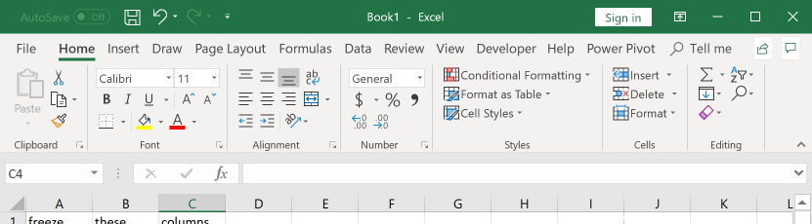
Customize Excel
To modify basic workbook properties in Excel, you can use the Ribbon on the top portion of Excel. This ribbon contains several categories (called groups) that each contain options and functions for their related variables. For example, on the Home tab, in the Font group, you can change the font style or size.
Another way to change basic workbook properties is to go to File > Options. The Excel Options box opens containing tabs for customizing and manipulating several options, such as Language and Formula settings.

Slide 11
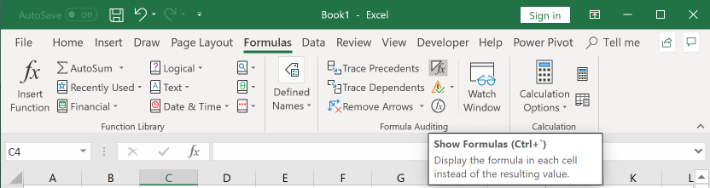
Customizing Excel
To display formulas in Excel, on the Formulas tab, in the Home group, select the Show Formulas button.
You can also press (Ctrl+ `)

Slide 12
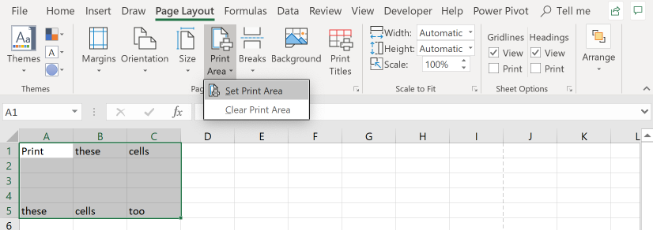
Configure Excel for Collaboration
To set a print area in Excel, select a range of cells. Then, on the Page Layout tab, in the Page Setup group select Set Print Area.

Slide 13
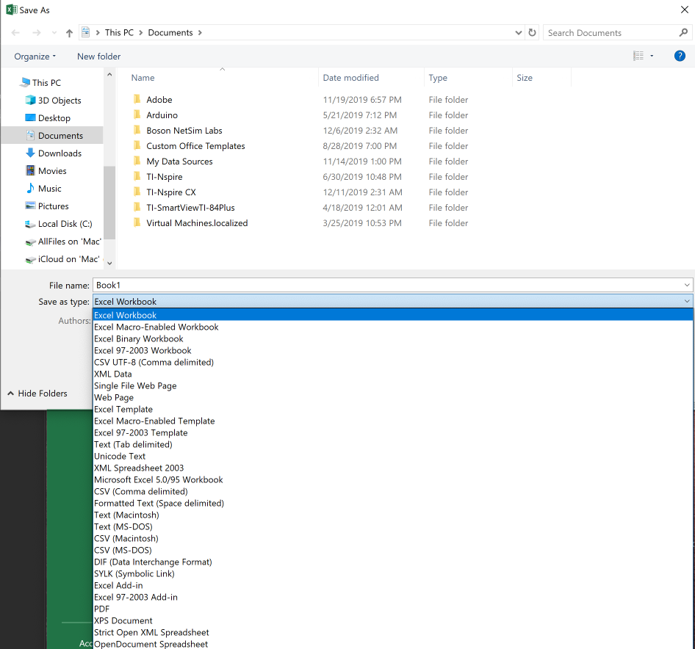
Configure Excel for Collaboration
To save workbooks in alternative file formats, go to File > Save As. Select the location you wish to save your file, and after naming your file, select the Save as type options arrow to select from a variety of file types.

Slide 14
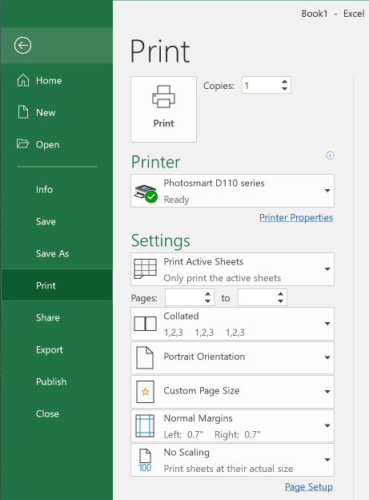
Configure Excel for Collaboration
To configure print setting in Excel, go to File > Print. The Print page opens, with settings to configure options such as the amount of copies, which pages to print, and margin customization.

Slide 15

Configure Excel for Collaboration
To inspect the workbook for issues in Excel, go to File > Info. On the Info page, select the Check for Issues arrow-button near the Inspect Workbook heading.
To inspect the document for hidden properties or personal information, select the Inspect Document option. The Document Inspector box opens, allowing you to specify what to inspect in the workbook.

Slide 16
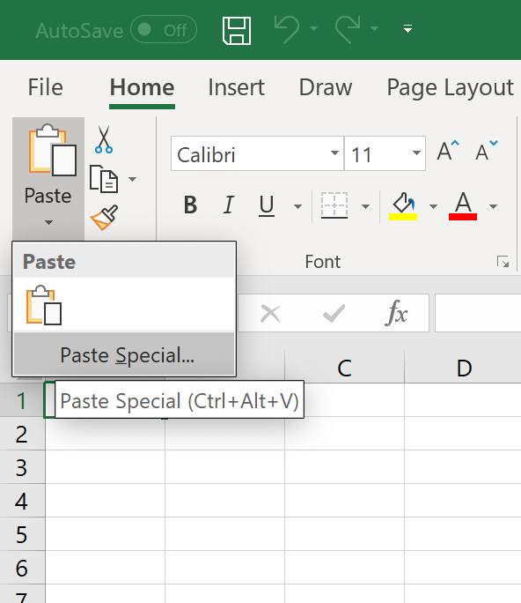
Manipulate Data in Excel
To paste using special options in Excel, simply click the arrow on the Paste button, which lies on the Home tab, in the Clipboard group. Then, select Paste Special (or press Ctrl + Alt + v).

Slide 17
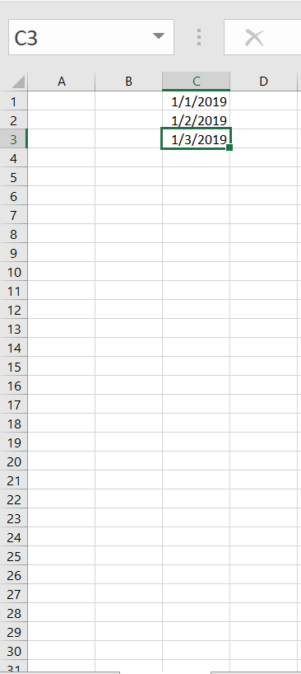
Manipulate Data in Excel
To fill cells by using Autofill, select an active cell and enter a data type in the cell, such as dates. Then, click and drag the green square in the lower right corner of the active cell to the range of cells you wish to fill.
See Figure A1. To autofill the rest of January in column C, simply click and drag the green square in the lower right corner of cell C3, and drag it to cell C31. This will automatically add the dates up to 1/31/2019.
Figure A1

Slide 18
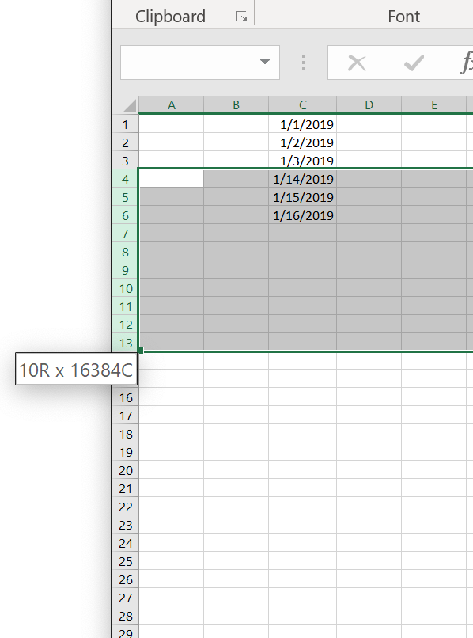
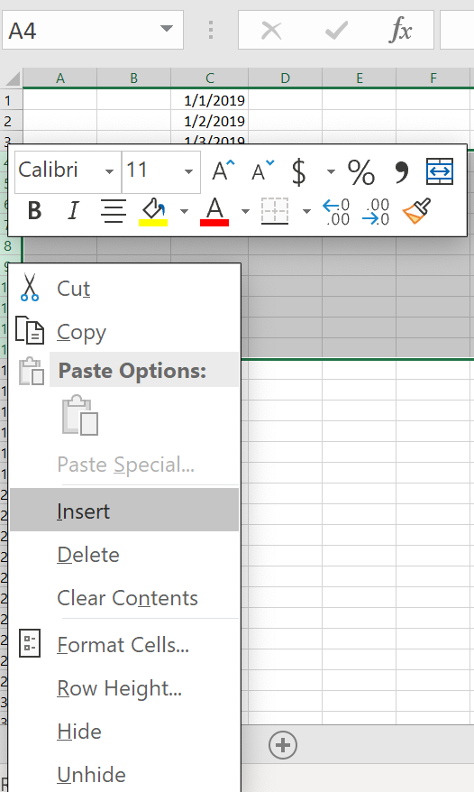
Manipulate Data in Excel
To insert multiple rows in Excel, click and drag a number on the column bar, to the corresponding number of rows you wish to add. Then, right click select Insert on the shortcut menu. (Shortcut Menu shown in figure B2).
See Figure B1
For example, In row C (Figure B1) there are 10 days between 1/3/2019 and 1/14/2019. Let’s say wish to insert 10 rows between cells C3(1/3/2019) and C4(1/14/2019), in order to properly adjust the dates. Just click and hold row 4, and drag it to row 13, which adds 10 new rows to the worksheet. You can use Autofill to add the missing 10 dates.
Figure B1
Figure B2

Slide 19
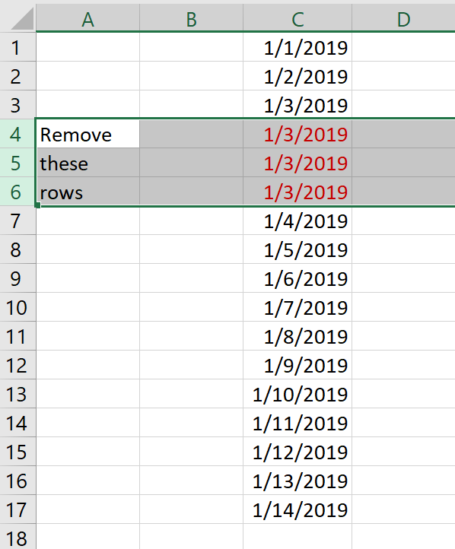
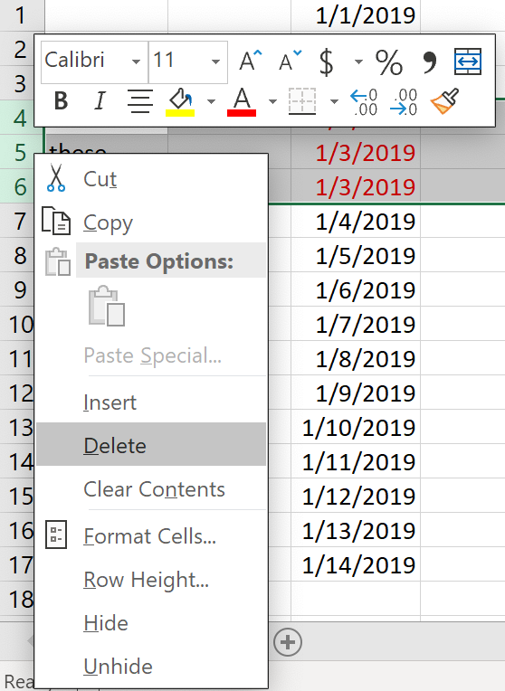
Manipulate Data in Excel
If you want to remove multiple rows in Excel, the process is almost the same as adding rows.
See Figure C1
Let’s say you want to remove the three rows containing the repeated dates in red in Cells C4:C6, simply select the range of rows you wish to delete, right click one of the rows, and click Delete on the shortcut menu.
The Delete option on the Shortcut Menu is shows in Figure C2.
Figure C1
Figure C2

Slide 20
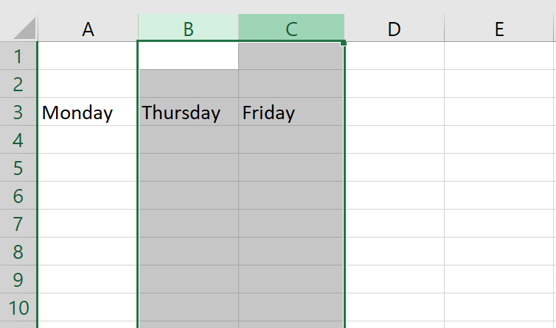
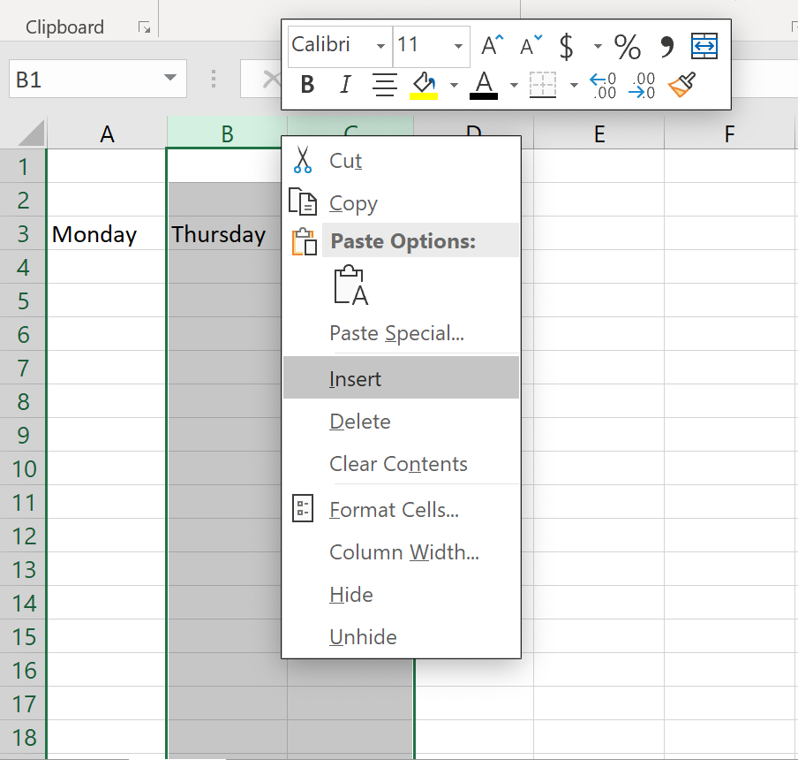
Manipulate Data in Excel
Figure E1
If you wish to add multiple columns in Excel, select the number of columns you wish to add. Then right click, and in the Shortcut Menu, select Insert.
See Figures E1 and E2
Let’s say you wish to add 2 columns between columns A and B, so that you can add the two days that lie between Monday and Thursday. Since you want to add 2 columns, click and drag from column B to column C (as shown in Figure E1). Then, right click one of the selected columns, and in the Shortcut Menu, select Insert (as shown in Figure E2).
Figure E2

Slide 21
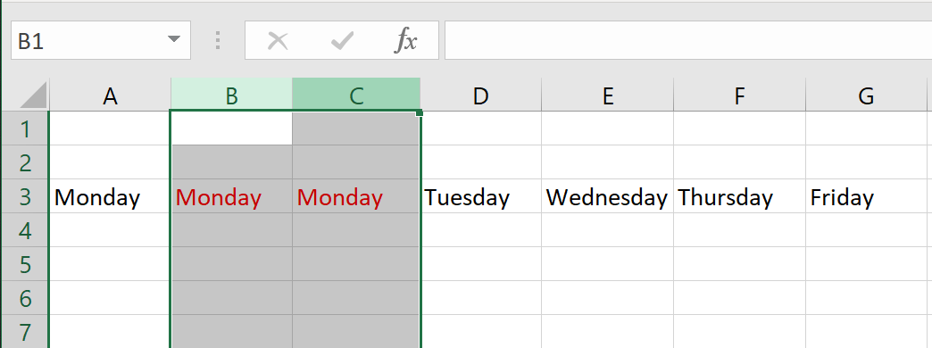
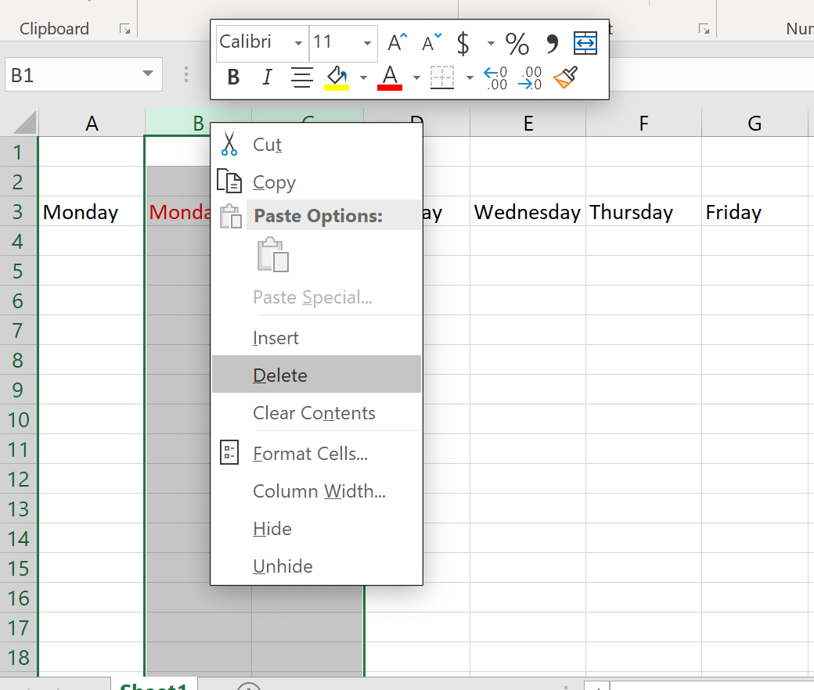
Manipulate Data in Excel
Figure D1
If you wish to remove multiple columns in Excel, select the range of columns you wish to delete.
For example, to remove the repeated Monday highlighted in red in columns B and C, simply click column B and drag to Column C (as shown in Figure D1). Then, right click on one of the selected columns, and in the Shortcut Menu select Delete (as shown in figure D2).
Figure D2

Slide 22
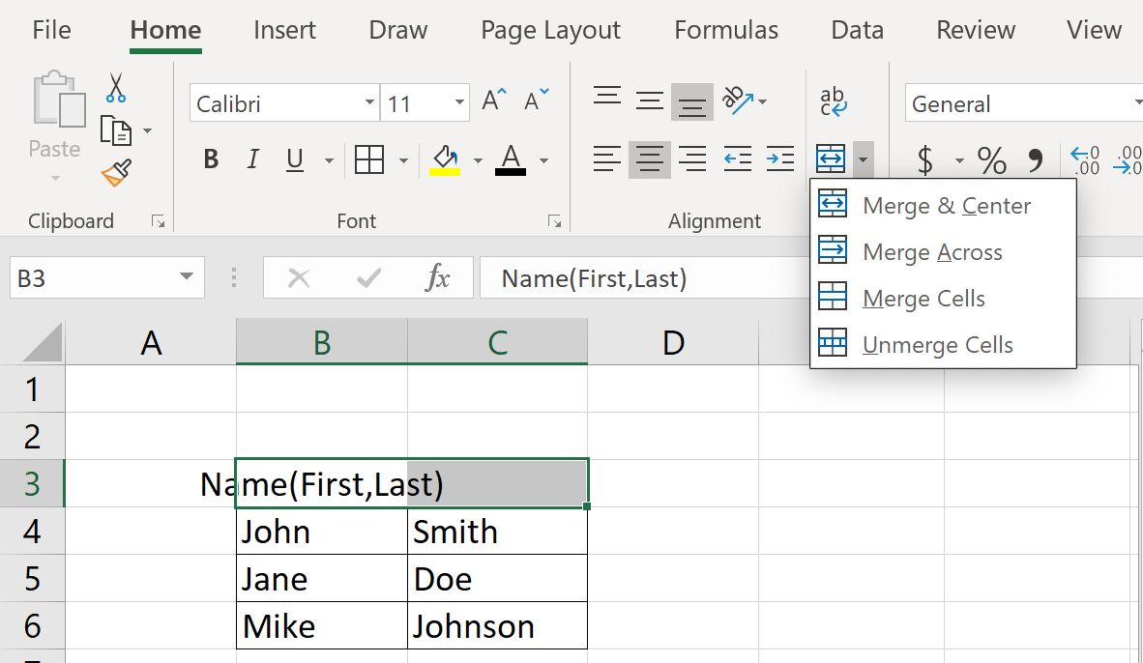
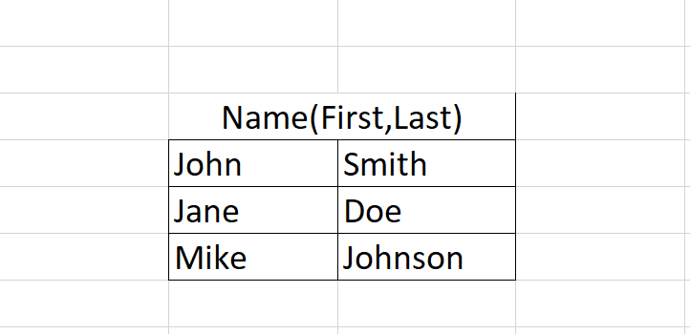
Formatting in Excel
To merge cells in Excel, highlight the range of cells you wish to merge. Then on the Home tab, in the Alignment group. Click the Merge & Center icon, or click the adjacent arrow to select other merging options.
Figure F1 shows the cells in the range B3:C3 after they have been merged & centered. As you can see, the range of cells is aligned much more neatly and looks more appealing.
Figure F1

Slide 23
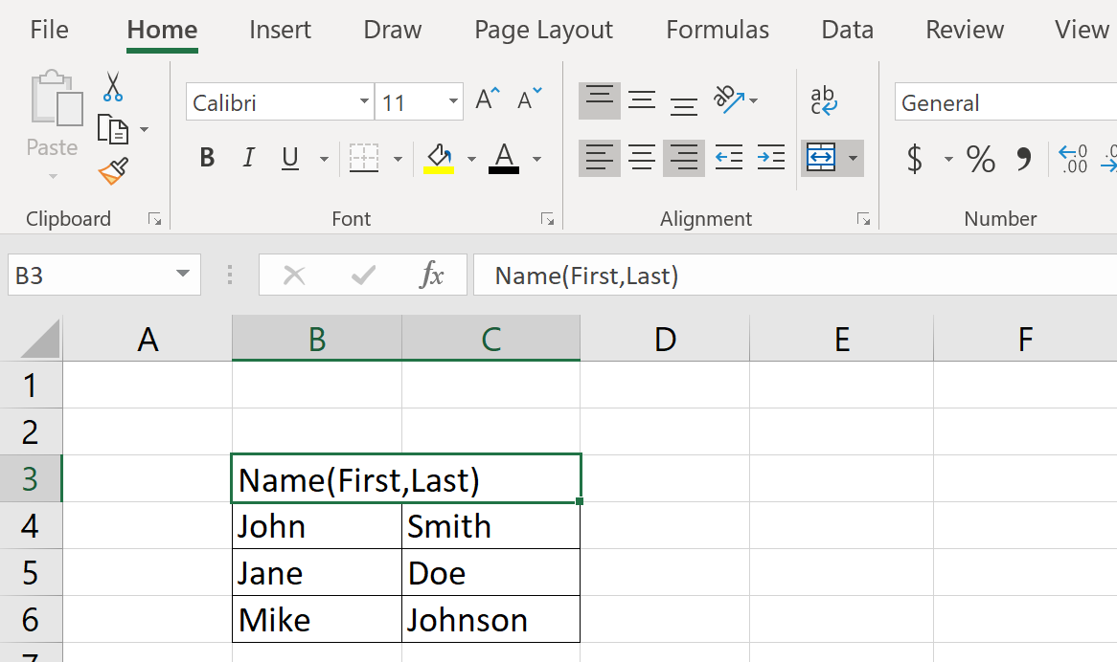
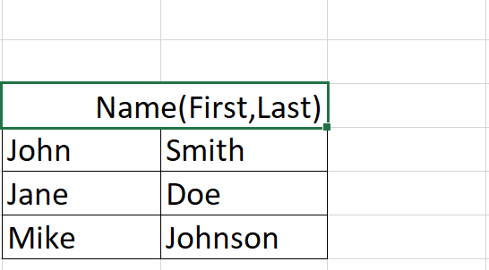
Formatting in Excel
For example, to align the data in cell B3 to the right, simply select B3 as the active cell, and on the Home tab, in the Alignment group, and selecting Right Align.
Cell alignment, orientation, and indentation can all be easily done by clicking their respective icons, all closely located to each other on the Home tab, in the Alignment group.
Figure G2.
Figure G1
Figure G2 shows the effect that Right Align
has on the alignment of a cell’s data.

Slide 24
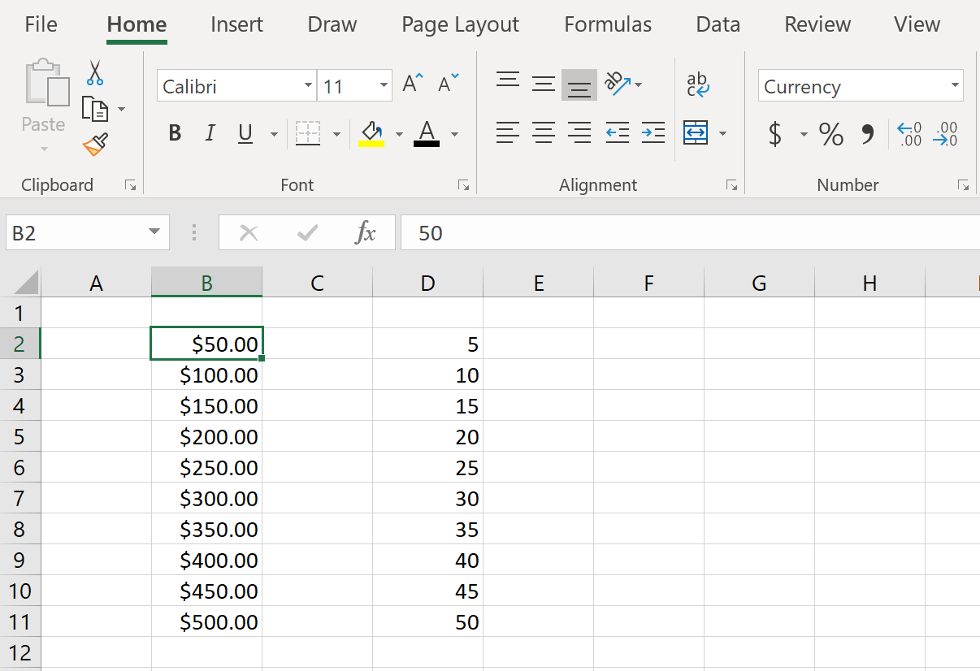
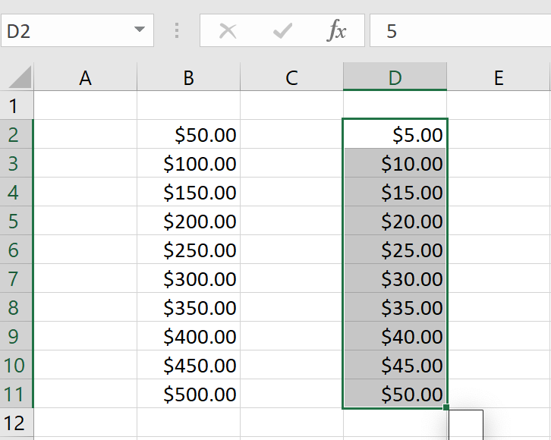
Formatting in Excel
You can format cells by using the Format Painter, location the Home tab, in the Clipboard group.
The cells in Column B are in Currency format, while the cells in Column D General format. To copy the formatting from Column B to Column D, select a cell from Column B. Then select the Format Painter icon in the Clipboard group. Next, click and drag over the range of cells you wish to apply the copied format to.
Figure H2 shows the effect that using Format Painter has on the cells in Column D.
Figure H1
Figure H2

Slide 25
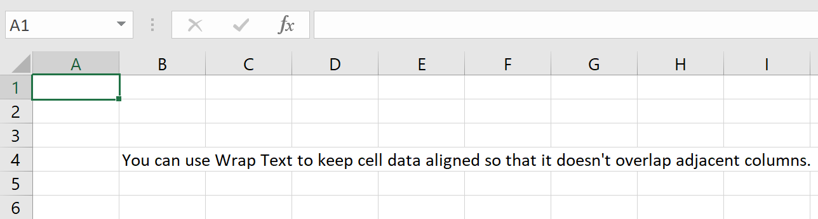
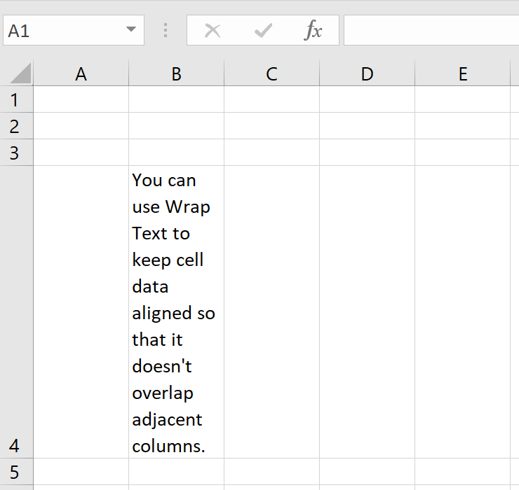
Formatting in Excel
You can use the Wrap Text option, on the Home tab, in the Alignment group to keep cell data from overlapping into other columns.
Figure I2 shows the effect that using Wrap Text has on cell B4. Rather than overlapping into columns C:I, the data in cell B4 extends the row width, allowing the data to be aligned vertically, and preventing it from overlapping adjacent columns.
Figure I1
Figure I2

Slide 26
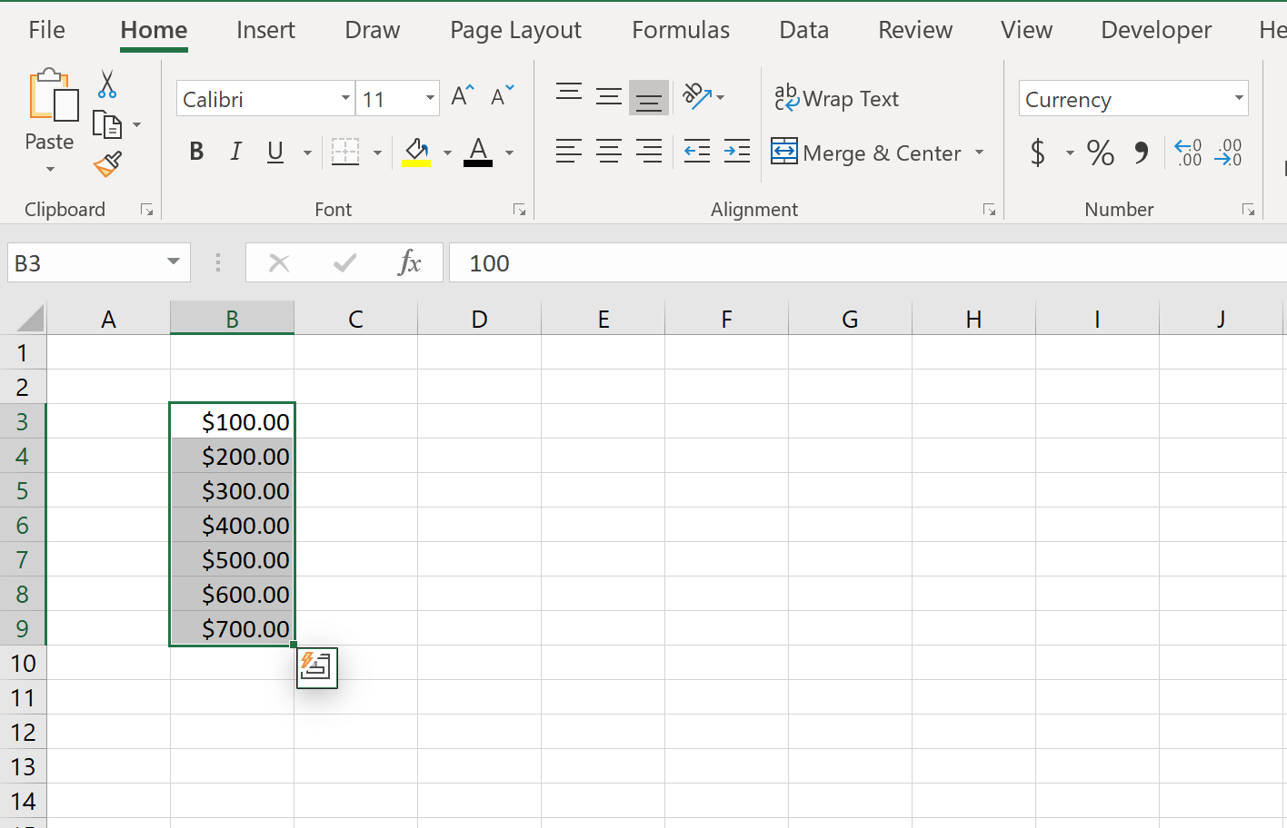
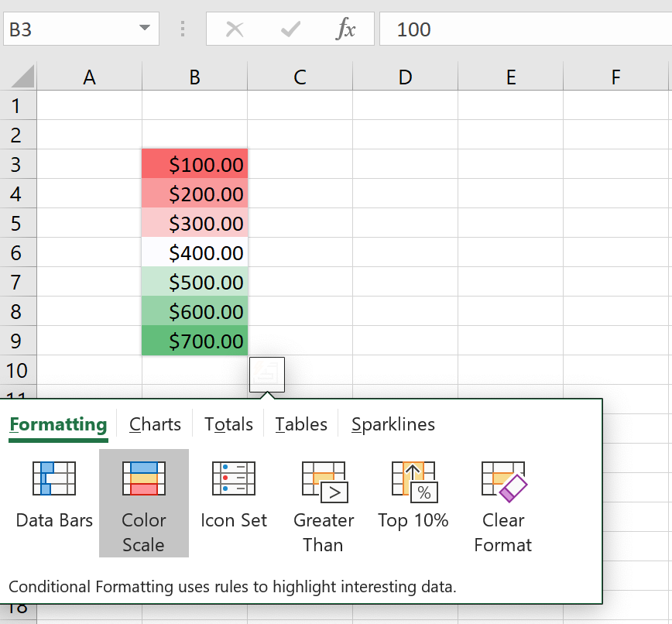
Formatting in Excel
Applying number formats is quite easy in Excel, and there are several ways to do so. Simply select the range of cells you wish to format, then on the Home tab, in the Number group, select the drop-down arrow. The default setting may be set to General. Select the format you wish to use from the drop-down menu.
The range B3:B9 shows cells that are set to the Currency format using the drop-down arrow in the Numbers group.
Another way to format numbers in Excel is with the Quick Analysis (Ctrl + Q) tool. Figure J2 shows the visual effects that a Color Scale conditional formatting has on the data, assuming that in this instance, higher = better.
Figure J1
Figure J2

Slide 27
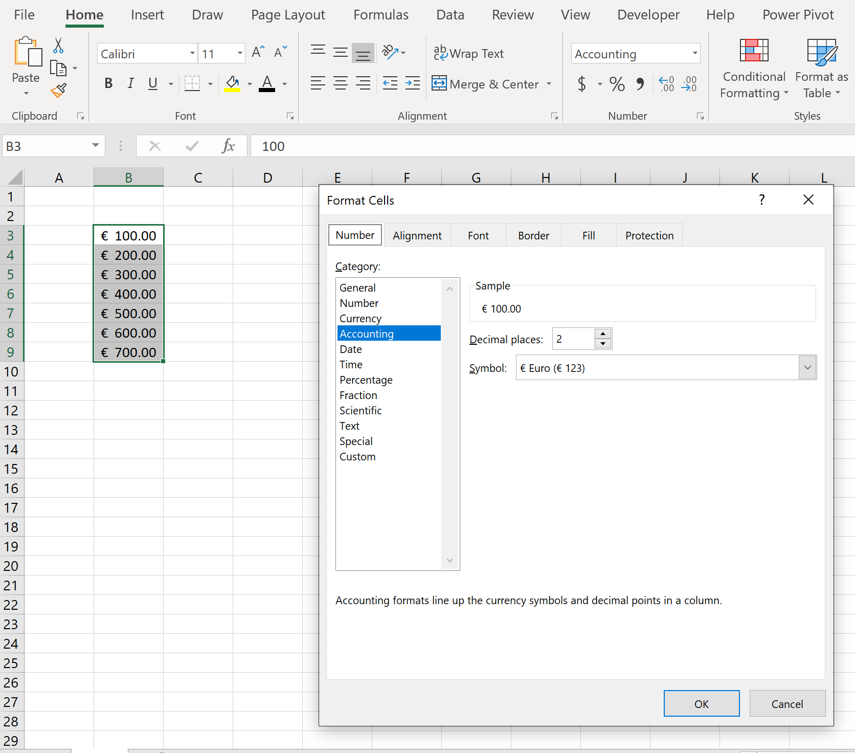
Formatting in Excel
You can also format cells using the Format Cells dialogue box, which offers more advanced formatting options.
If an accountant in Europe needed to format some data into Euros, this can be done in the Format Cells dialogue box. The dialogue box can be accessed by clicking the drop-down arrow in the Number group, and selecting More Formatting Options.

Slide 28
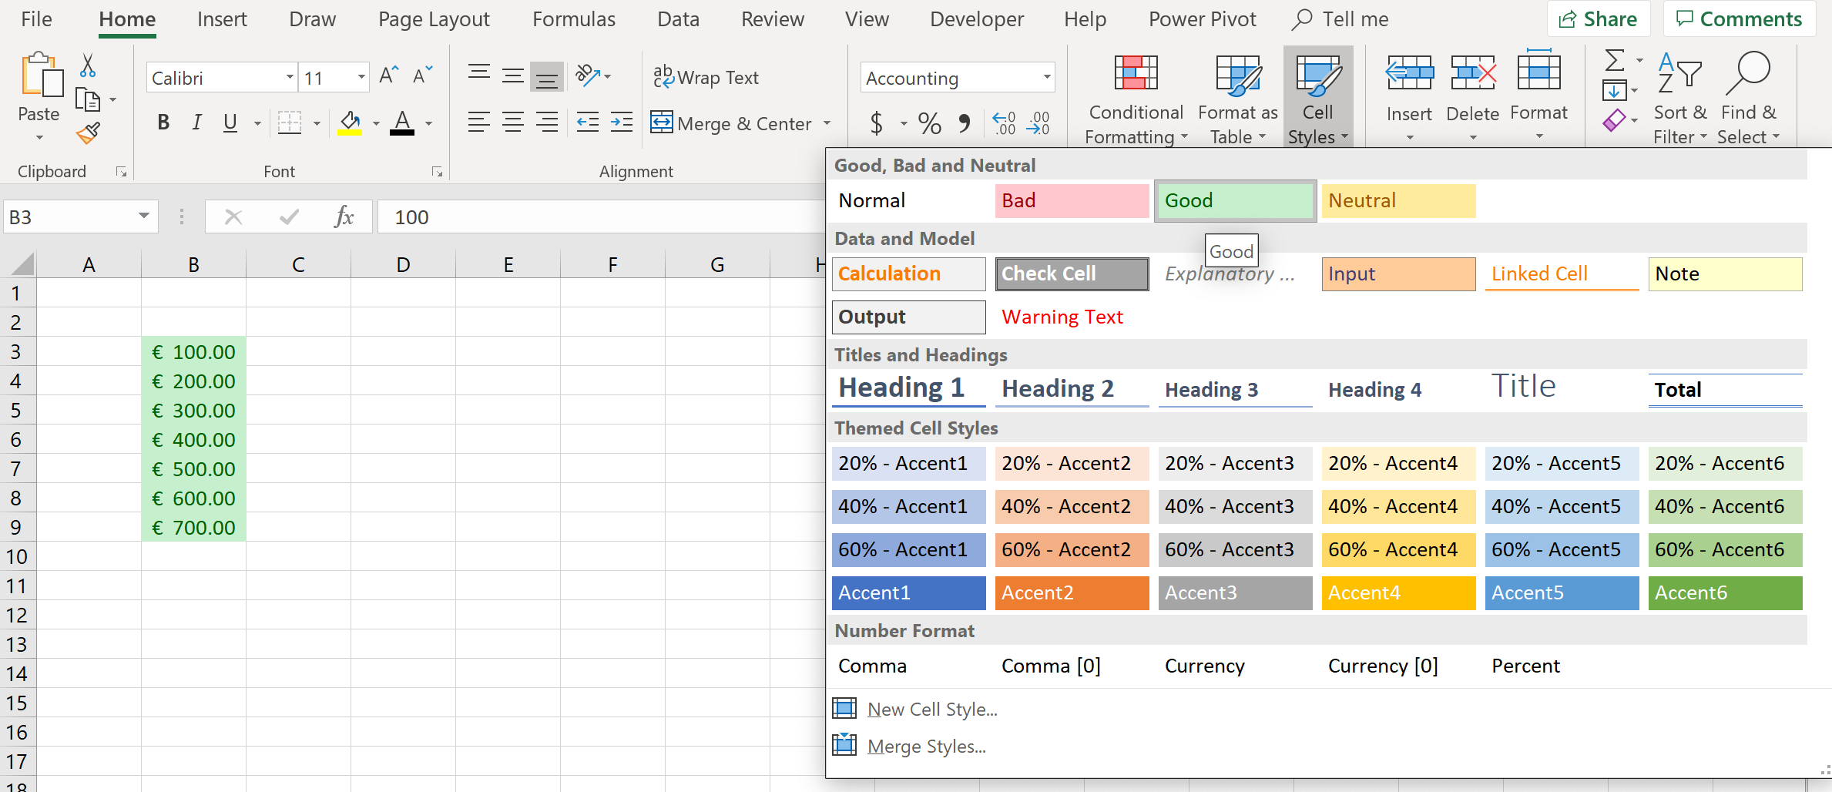
Formatting in Excel
You can add Cell Styles to specific cells by clicking the Cell Styles arrow, located on the Home tab, in the Styles group.
The selected cells below have been formatted using the Good formatting (3rd option in 1st row), assuming that positive values are considered good in this instance.

Slide 29
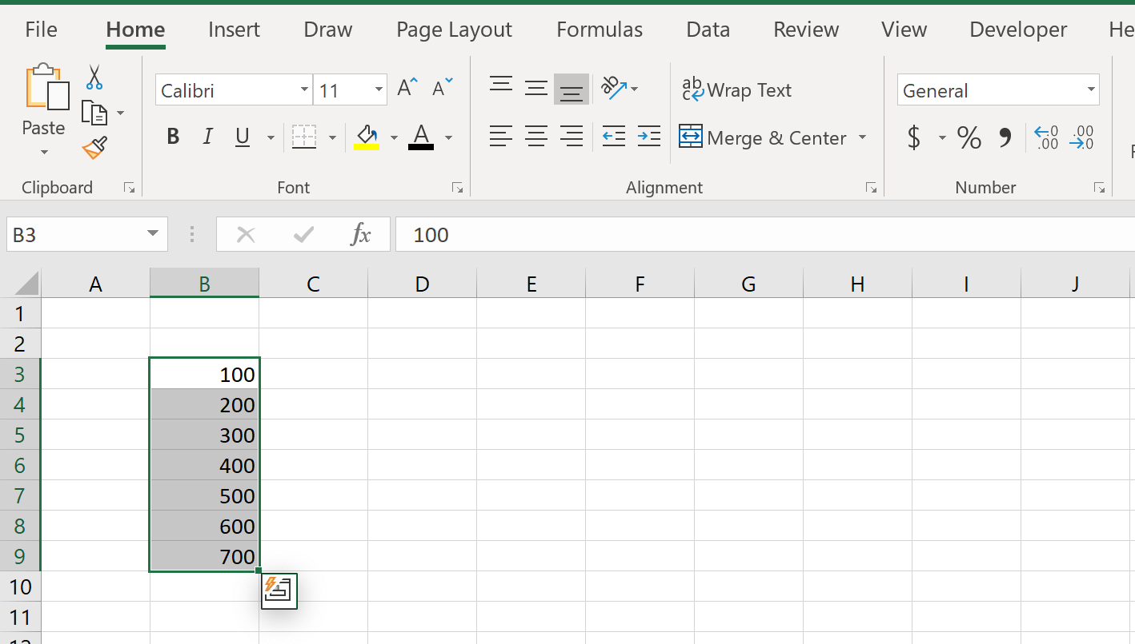
Formatting in Excel
To clear cell formatting, simply click the drop-down arrow in the Number group, and select General.

Slide 30
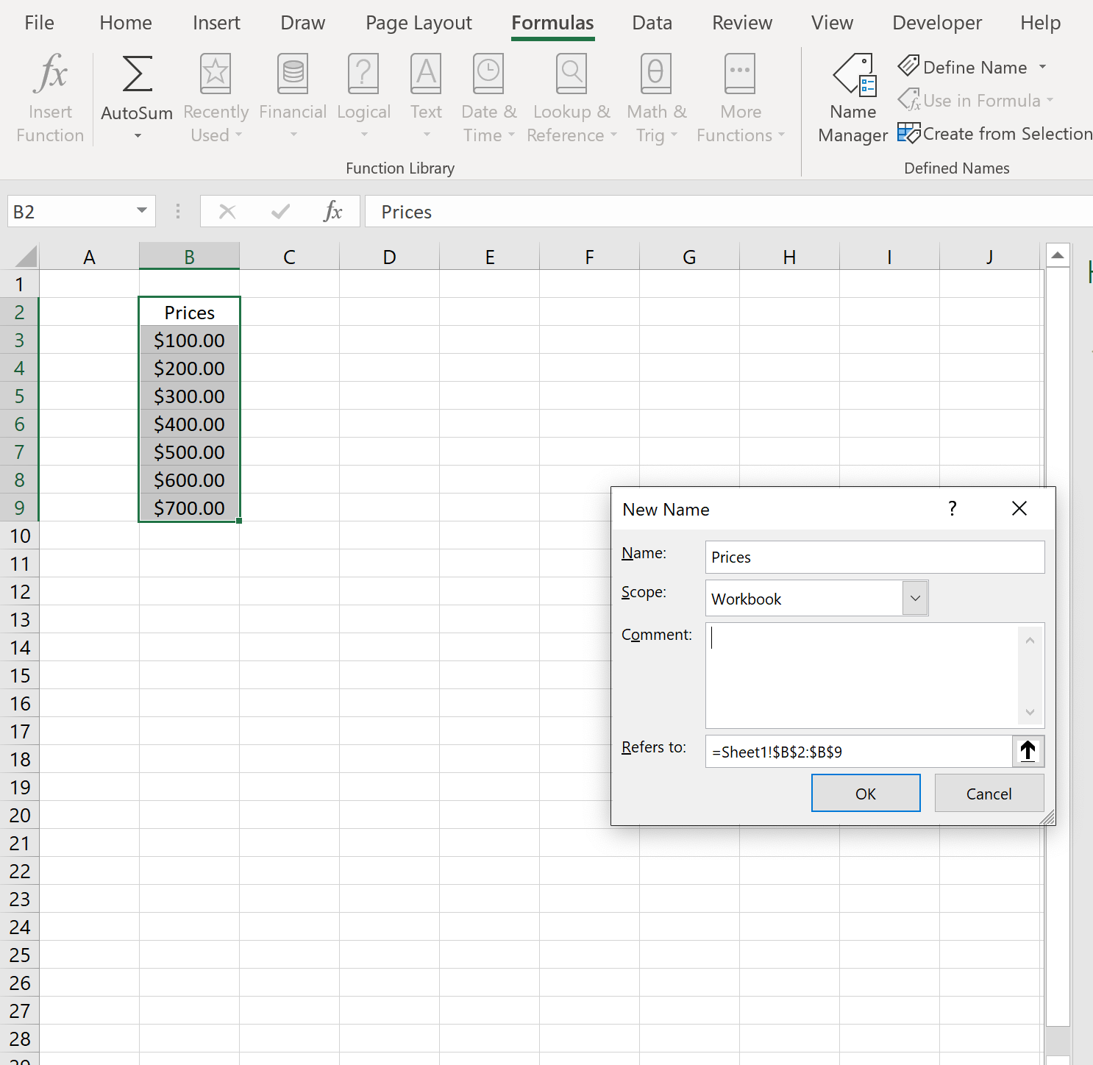
Defining and Referencing Named Ranges in Excel
You can define a named range in Excel by using the Define Name function, located on the Formulas tab, in the Defined Names group.
The Define Name function allows you to define the name and scope of the name throughout the workbook.
The Define Name function automatically names the range with the header/footer if you have entered one.

Slide 31
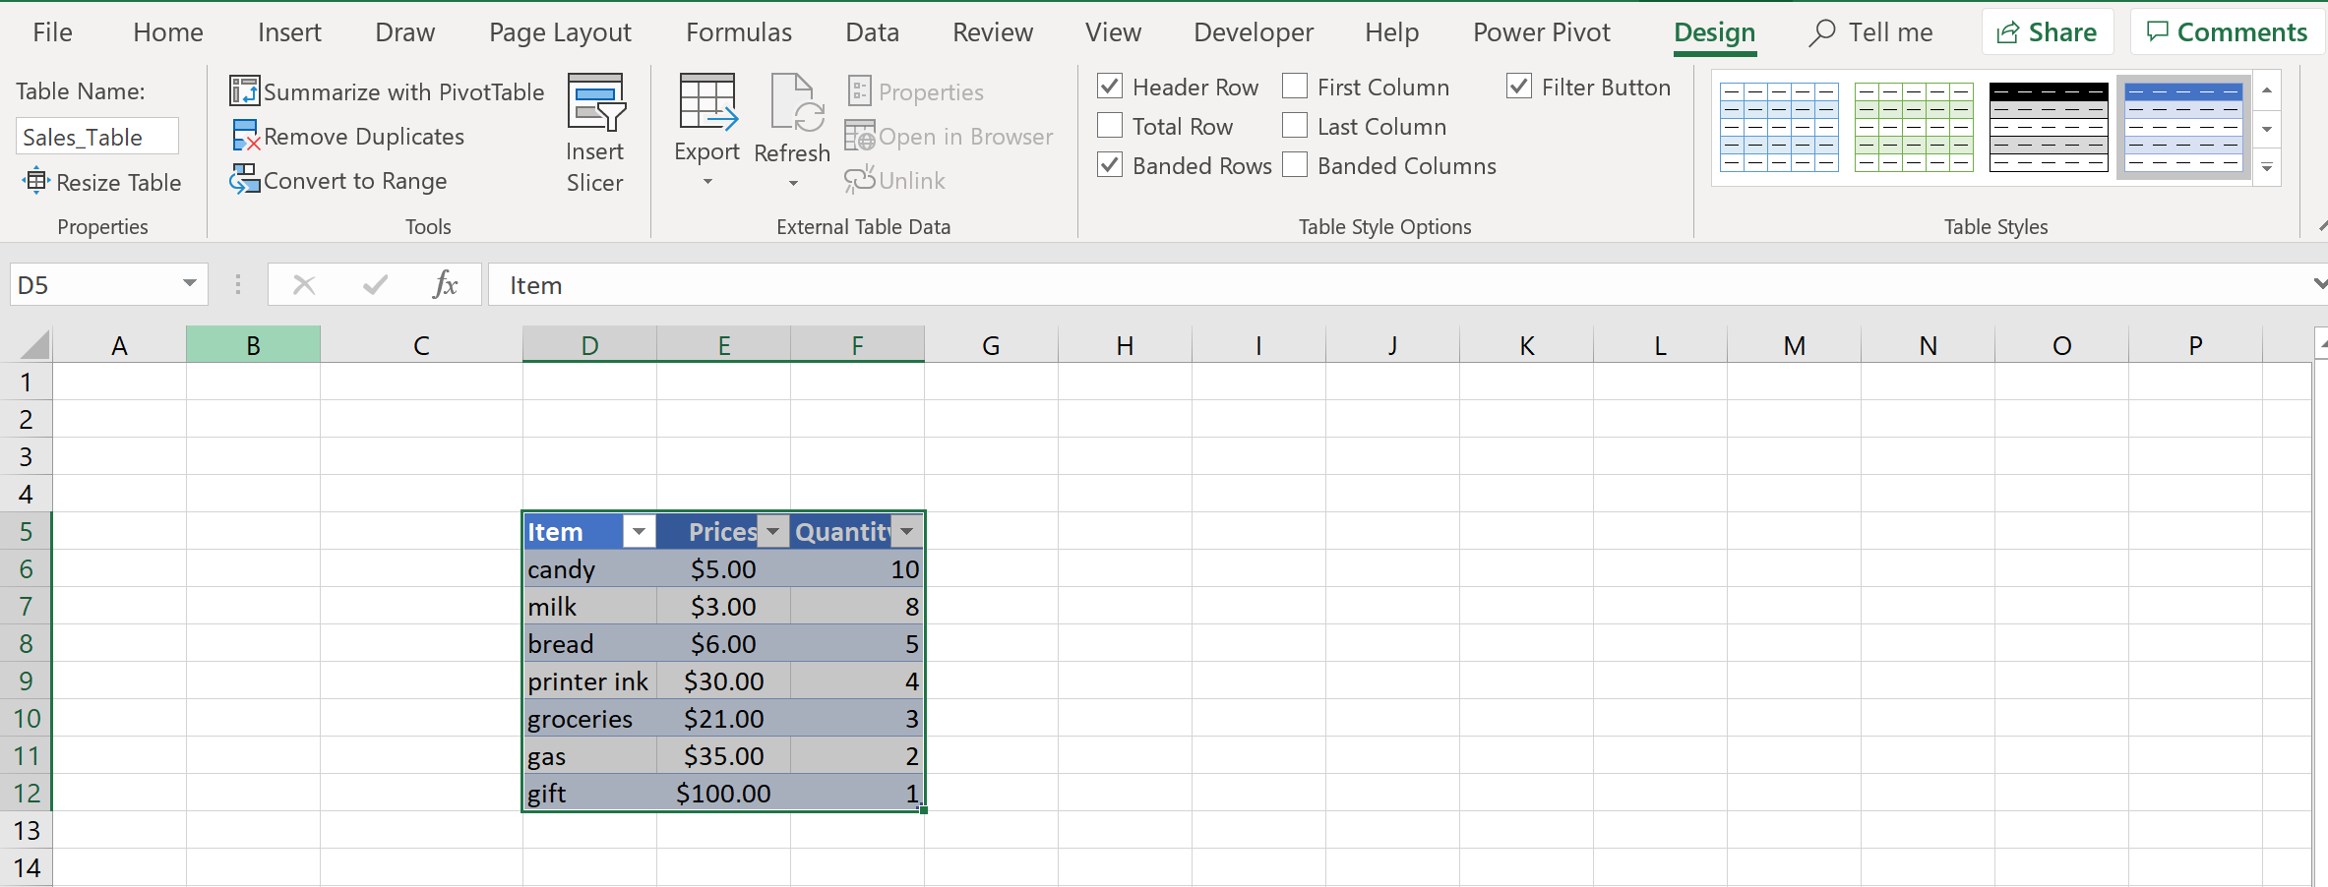
Defining and Referencing Named Ranges in Excel
If you want to name a table in Excel, simply make the table active by clicking on it, and on the Design tab, in the Properties group, you can enter a name that corresponds to the data in the table.
For example, the table in the image below is named “Sales_Table”.

Slide 32
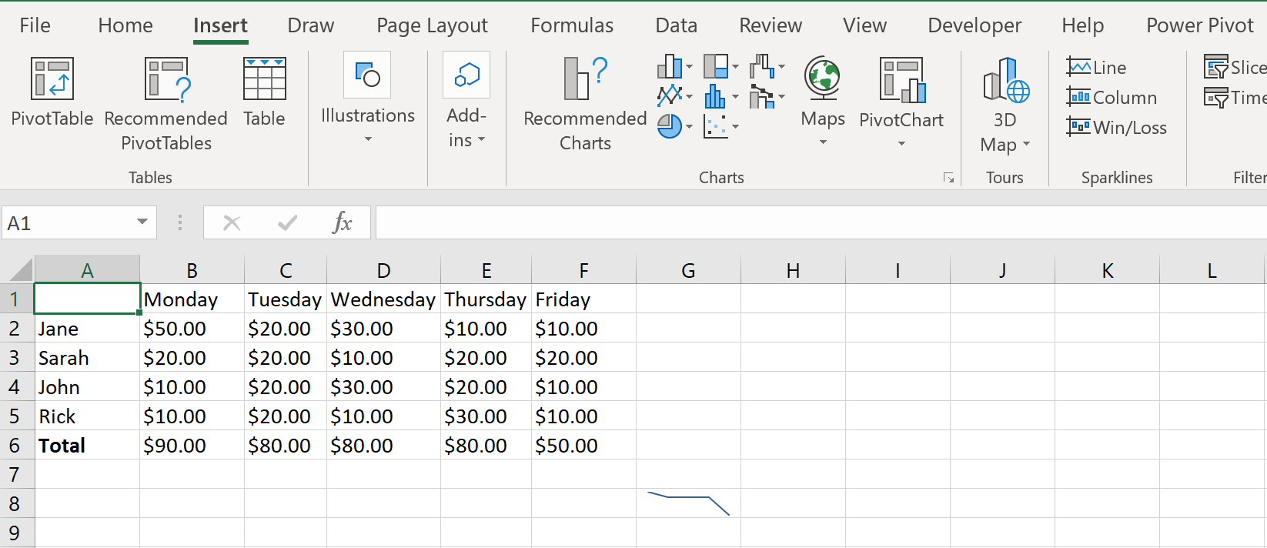
Summarizing Data Visually in Excel
To visually represent trends in data, you can use Sparklines. Sparklines come in different styles, such as Line, Column, and Win/Loss Sparklines.
To add a Sparkline, go to the Insert tab, and refer to the Sparklines group. Cell G8 in the image below contains a Line Sparkline, showing the declining trend in the Total column shown in column 6.

Slide 33
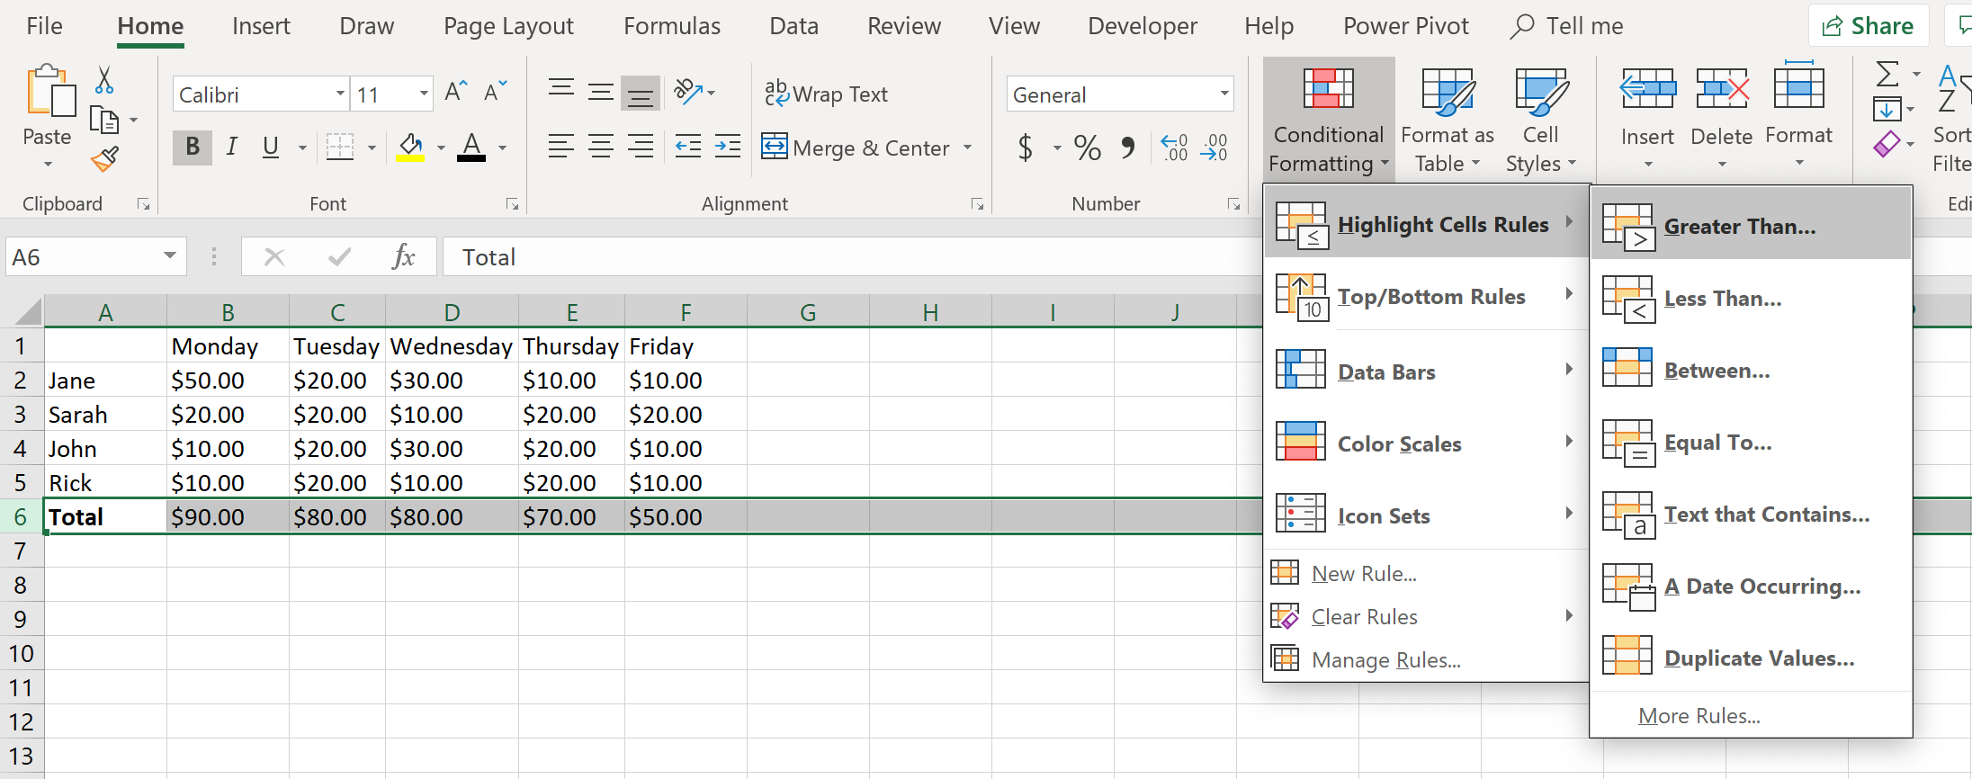
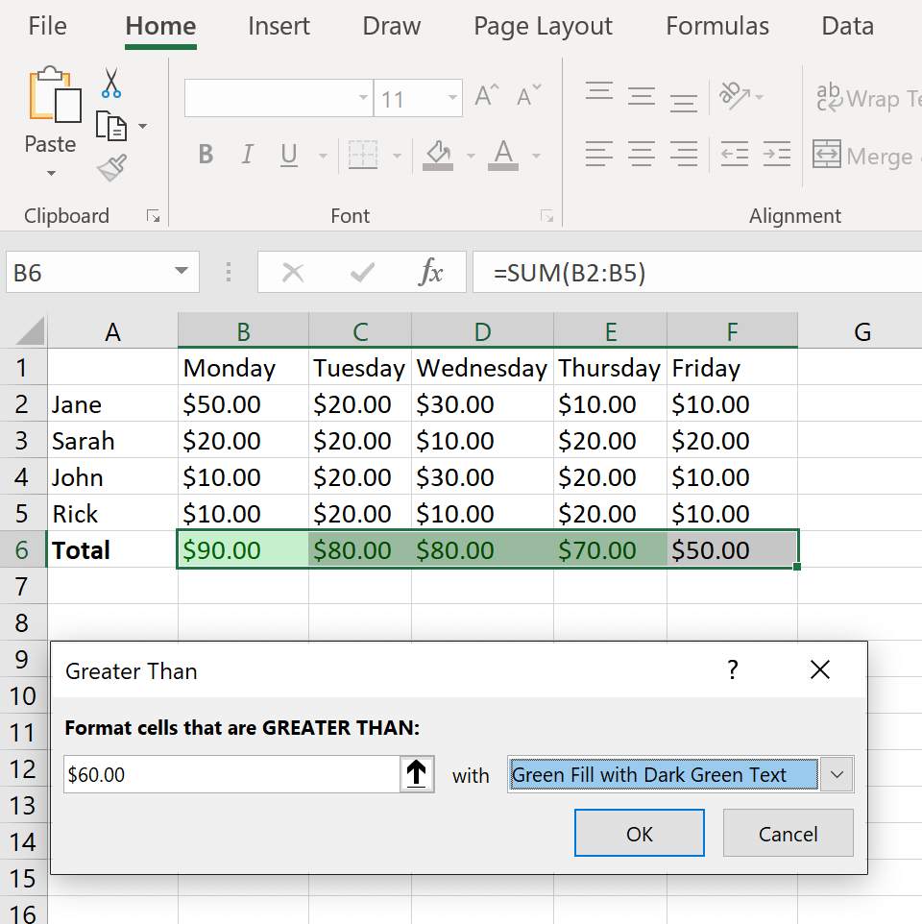
Summarizing Data Visually in Excel
You can also visually represent trends or significant values in Excel using built in Conditional Formatting.
Looking at Figure K1, let’s say you wanted to format the cells in Column 6 to be green if the value of the daily total was greater than $60.
Figure K2 shows the visual effect that the Greater Than conditional formatting has, when the range of cells is GREATER THAN $60.00.
Figure K1
Figure K2

Slide 34
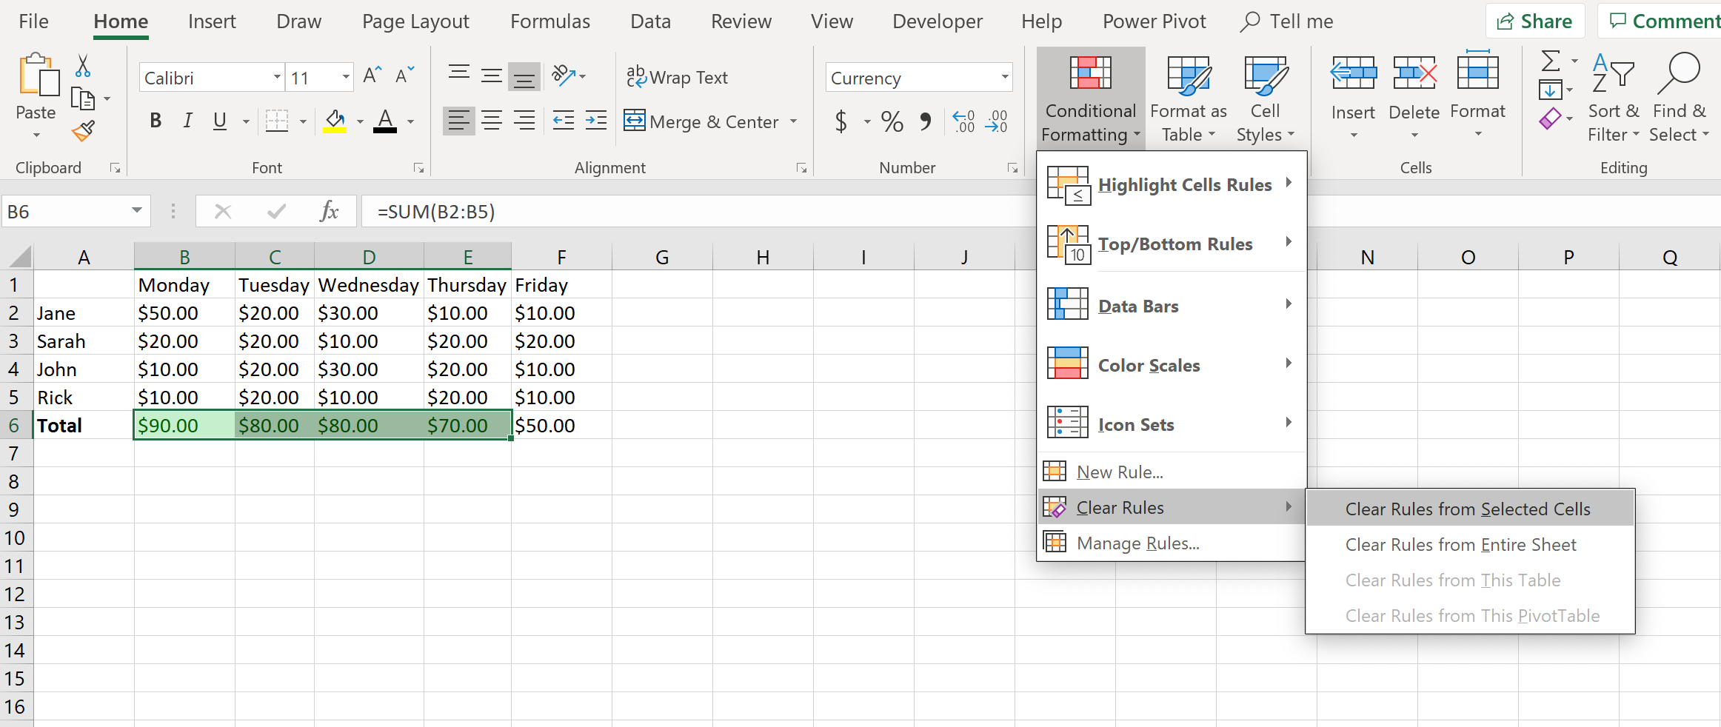
Summarizing Data Visually in Excel
Clearing cell formatting is simple in Excel. On the Home tab, in the Styles group, select the Conditional Formatting drop-down arrow, and select Clear Rules.
You can decide to the clear the formatting from cells, entire sheets, or tables.

Slide 35
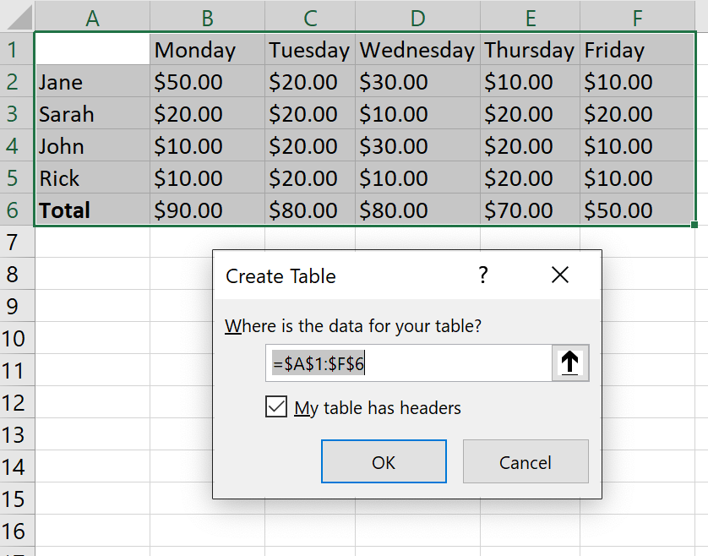
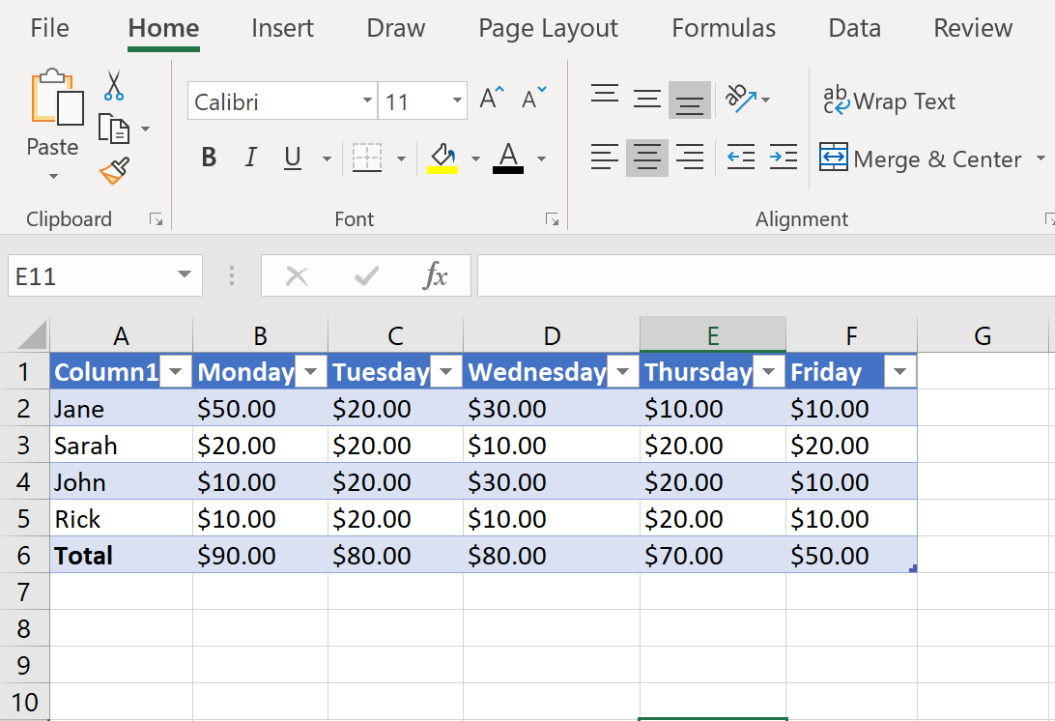
Create and Format Tables in Excel
Creating tables in Excel is relatively straightforward. Simply select your range of data, then on the Insert tab, in the Tables group, select Table.
The Create Table dialogue box opens, allowing you to specify the data range if needed. You can also include headers in your table.
Figure L1 shows the Create Table dialogue box, where you can specify the range and choose to include a header on your table.
Figure L2 shows the data converted into a table.
Figure L1
Figure L2

Slide 36
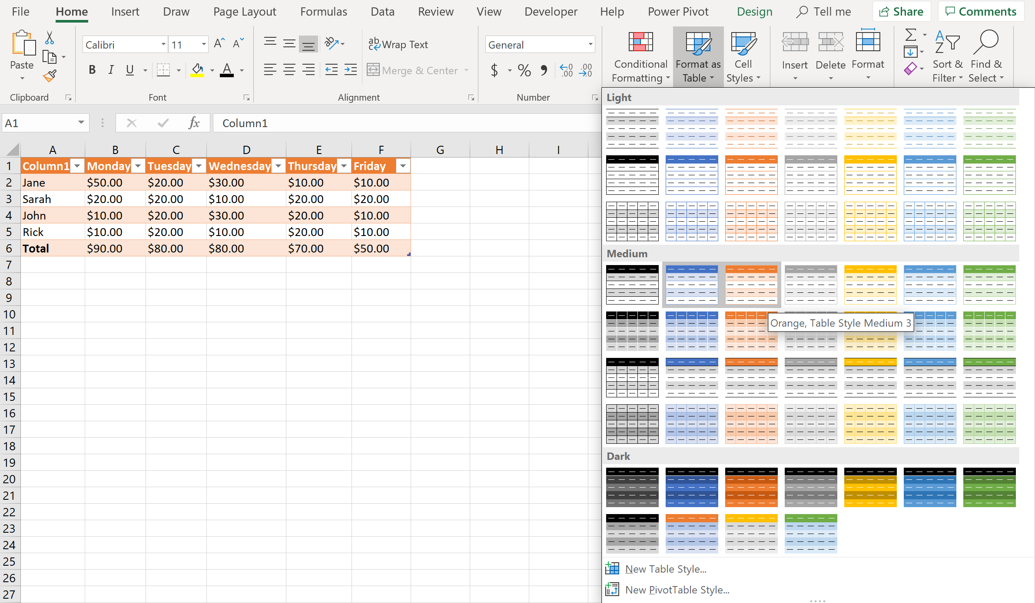
Create and Format Tables in Excel
To add a style to your table, on the Design tab, in the Styles group, select the Format as Table drop-down arrow. The table below shows the style Orange, Table Style Medium 3 applied to the table below.

Slide 37
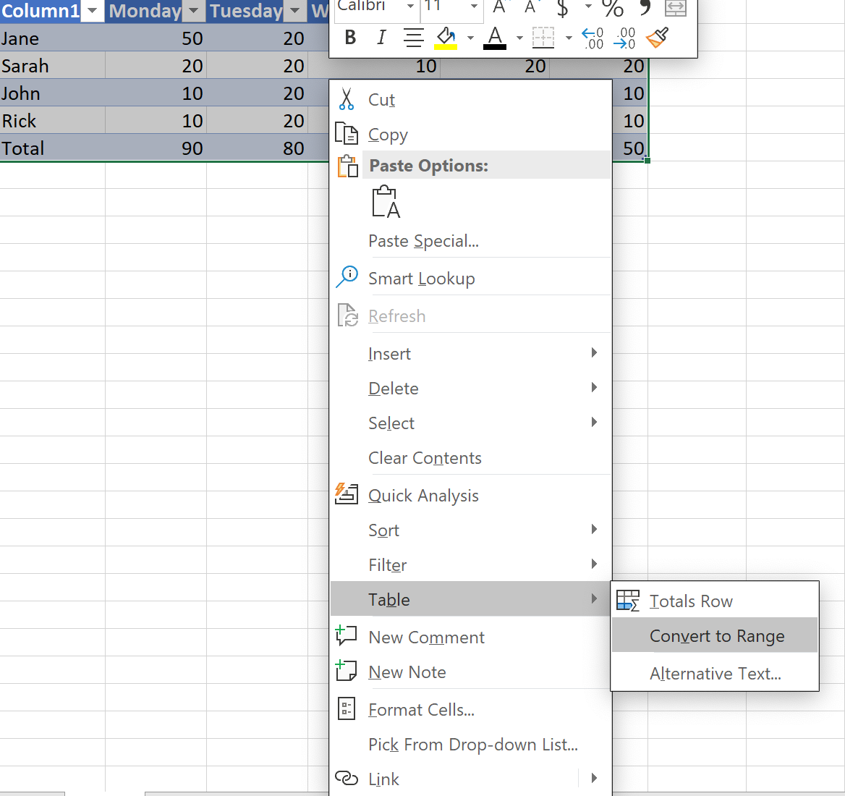
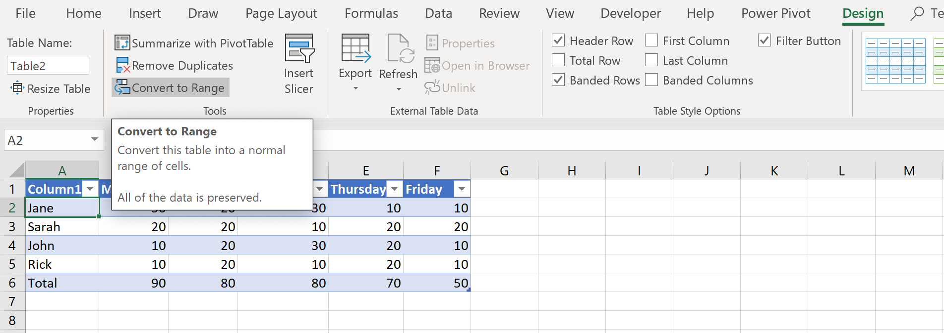
Create and Format Tables in Excel
You can convert a table to a cell range by right clicking on the table, going to the Table option, and selecting Convert to Range.
You can also convert a table to a cell range by using the Convert to Range tool, located on the Design tab, in the Tools group.

Slide 38
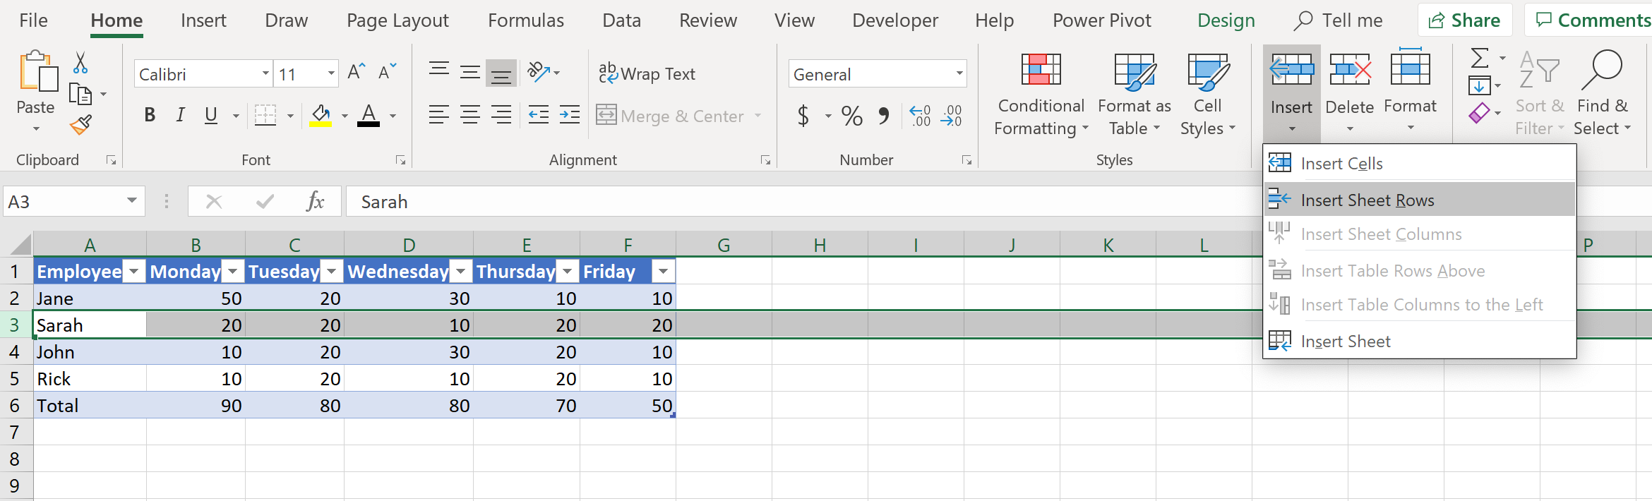
Modifying Tables in Excel
Adding and removing rows and columns to tables can be accomplished the same way as adding or removing rows and columns to other data.
To add a row between rows 3 and 4, simply select row 3, and on the Design tab, in the Cells group, select the Insert drop-down arrow, and select Insert Sheet Rows.
To remove a column or row from a table, select the range of row(s)/column(s) you wish to delete, right click on an active range of rows/columns, and in the Shortcut Menu, press Delete.
Tip: While there is a also Delete drop-down arrow in the Cells group, The Shortcut Menu can be used to both insert & delete rows/columns.

Slide 39
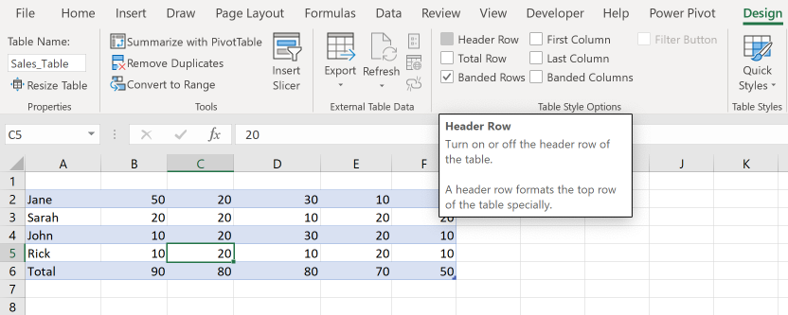
Modifying Tables in Excel
To configure table style options, on the Design tab, in the Table Style Options group, select which configurations you’d like enabled.
For example, if you wanted to remove the Header Row from the table, uncheck the Header Row box in the Table Style Options group
You can also add other configurations, such as adding a Total Row to the table by checking the Total Row box in the Table Style Options group.

Slide 40
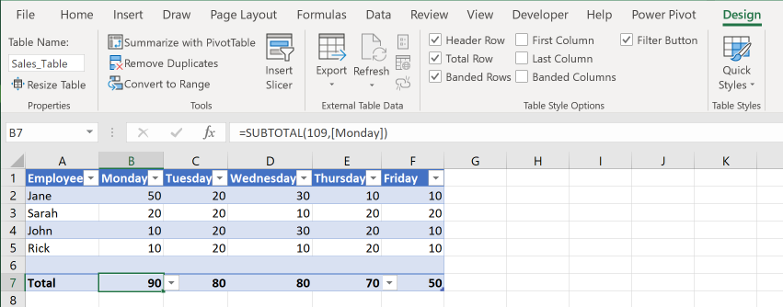

Modifying Tables in Excel
To add a Total row to the table, on the Design tab, in the Table Style Options group, check the Total Row box. The table in Figure M1 contains a row containing weekly totals at the bottom of the table.
Figure M1
To add any configurations to the Total row, simply click the drop-down arrow, shown in Figure M2, and select the configuration you wish to view.
Figure M2

Slide 41

Filtering & Sorting Data in Excel
You can filter records in Excel by clicking the Sort & Filter drop-down arrow, which is located on the Home tab, in the Editing group. Figure N1 shows that a filter has been added to the table.
Figure N1

Slide 42


Filtering & Sorting Data in Excel
Figure N2 shows a filter being enabled to only show data on the table from U.S. Bonds & U.S. Equities.
Figure N3 shows the effect that enabling the selected filters has on the table.
Figure N2
Figure N3

Slide 43

Filtering & Sorting Data in Excel
To sort data by multiple Columns in Excel, click the Sort & Filter drop-down arrow, located on the Home tab, in the Editing group. Next, select Custom Sort. The Sort dialogue box opens, allowing you to configure how your data is sorted.
The data in the image to the right will be sorted first by U.S. Assets (colored in green), and then by Fund Assets, which are the prices to be sorted largest to smallest.

Slide 44

Inserting References in Excel
To add a relative reference to Excel, select a cell and enter a formula containing the cells to be referred to. For example, cell D4 contains a relative reference to cells B4 and C4, while cell D5 contains a relative reference to cells B5 and C5.

Slide 45

Inserting References in Excel
To add an absolute reference to Excel, select a cell and enter a formula containing the cells to be referred to, using the proper syntax for absolute references.
For example, since the Tax Rate is a constant 6%, to calculate the sales tax, each cell’s formula (in column D) needs to refer only to the value in cell G2, which contains the Tax Rate.
To use a cell as an absolute reference, when typing the formula refer to the cell as $Column$Row. For example, to use cell G2 as an absolute reference in a formula, refer to the cell as $G$2 to indicate it is an absolute reference. This will cause Excel to use the constant Tax Rate of 6% in all its Sales Tax calculations.

Slide 46

Inserting References in Excel
To add a mixed reference to Excel, you must either specify the row or column element of a cell’s coordinates to be absolute. For example, a multiplication table uses mixed references to calculate values across the table.

Slide 47

Calculate and Transform Data in Excel
Let’s say we wanted to find the average value of the data in the image to the right.
We will perform calculations using the AVERAGE() function in Excel. First, select a cell to store the average value in. If we want to store the average value of the range C51:C62 in cell C64, then, select cell C64 and enter =Average(C51:C62) and press enter.

Slide 48

Calculate and Transform Data in Excel
To find the maximum or minimum of a range of data, we use the corresponding Max() or Min() function.
In the image to the right, we store the minimum value of the range C51:C62 in cell C66 by selecting cell C66 and entering =Min(C51:C62)
Press enter after making sure that you’ve properly typed the formula.

Slide 49

Calculate and Transform Data in Excel
Let’s say you wanted to find the sum of the values lying in the range C51:C62 in the image to the right. To use the Sum function, select a cell you wish to store the sum value in.
Since we want to store the sum in cell C63, we will select cell C63 and type =sum(C51:C62) and press enter.

Slide 50

Calculate and Transform Data in Excel
The COUNT(), COUNTA(), and COUNTBLANK() functions can be used to determine the quantity of cells that contain any sort of data.
The COUNT() function counts the amount of cells only containing numbers in a range of cells.
The COUNTA() function counts the amount of cells that are not empty in a range of cells.
The COUNTBLANK() function counts the number of empty cells in a range of cells.
The image to the right shows the result of “=COUNT(K7:K20)“ in cell J23, for a value of 11, because there are 11 cells in the range with numeric values.
The result of “=COUNTA(K7:20)” returns a value of 13 in cell J25, because there are 13 cells that are not empty.
The result of “=COUNTBLANK(K7:K20)” returns a value of 1 in cell J27 because there is 1 empty cell in the range of data (cell K20 is empty).

Slide 51

Calculate and Transform Data in Excel
The IF() logical function can be used to make logical comparisons between one value and another expected value.
An IF() statement can have two results: True, or False.
Cell V24 contains the results of a logical IF() statement, with the formula =IF(T25=0,”Out of Stock”, “In Stock”)
In the image to the right, cell V24 contains a logical IF test that determines if the quantity of items in stock is equal to 0. Because the value in cell V24 is equal to 0, the test returns the value “Out of Stock” because the result is True.

Slide 52

Format and Modify Text in Excel
The RIGHT(), LEFT(), & MID(), functions can be used to extract text from the right end, left end, or middle portion of text.
The RIGHT() function contains the syntax “RIGHT(text,[num_chars])”
In the image to the right, cell T33 contains the string “text.” because the formula written in cell T33 is “=RIGHT(T31,5)” indicating Excel to extract the last five characters from the value in Cell T31.
The MID() function contains the syntax “MID(text, start_num, num_chars)”
For example, in the image to the right, Cell T43 contains the string “extract me” because the formula written in cell T43 is “=MID(T41,13,10)” which indicates Excel to refer to the value in cell T41, start the extraction at the 13th character, and end it 10 characters later. This returns the value of “extract me” in cell T43.

Slide 53

Format and Modify Text in Excel
You can use the UPPER() function to convert text or a reference to upper case. Syntax: “=UPPER(text)”
You can use the LOWER() function to convert text or a reference to lower case. Syntax: “=LOWER(text)”
The LEN() function returns the number of characters in a string. Syntax: “=LEN(text)”
In the image to the right, cell T33 contains the text in cell T31 with capitalization, using the formula “=UPPER(T31)”
The value in cell T43 is 6 because of its formula, which is “=LEN(T41)” which indicates Excel to count the number of characters contained in cell T41, which is 6.

Slide 54


Format and Modify Text in Excel
The CONCAT() function can be used to combine text from multiple ranges or strings, but it does not provide the ability to add any delimiters or constraints. Syntax: “=CONCAT(text1,[text2]…)”
See figure P1. Cell T34 contains the combined ranges of text (T30:T32), but does not contain any spaces, or commas. You can use the TEXTJOIN() function to add a delimiter.
Figure P1
The TEXTJOIN() function combines text from multiple ranges or strings, but includes a specified delimiter between each value that is to be combined. Syntax: “=TEXTJOIN(delimiter, ignore_empty, text1, [text2]…)”
For example, in Figure P2, cell T44 contains the combined ranges of text (T40:T42), but also includes a delimiter indicating Excel to add a comma & space between each value to be combined.
Figure P2

Slide 55

Create Charts in Excel
Creating charts and sheets for charts in Excel is relatively easy. Select a range of data, then on the Insert tab, in the Charts group, select a chart, or select Recommended Charts to see suggested charts suited to your data.
In the image to the right, Excel recommends a Pie Chart for the data in the Sales Percentage table (E37:F41), because there is a relatively small quantity of data in percentages to be charted.

Slide 56

Modify Charts in Excel
You can move charts to their own separate sheets in Excel using the Move Chart tool, located on the Design tab, in the Location group.
The image to the right shows the Move Chart dialogue box, which allows you to determine exactly where the chart is moved to. In this example, the chart is moved to its own sheet in the workbook, called Sales Chart.

Slide 57

Modify Charts in Excel
You can add a data series to a chart. Look at the image to the right. The updated chart contains the added state of Pennsylvania:20.00%. The chart will not automatically update to include the new data. To update the chart to include the new data, drag the sizing handles surrounding the old data to include the new data, as shown in the image.

Slide 58

Modify Charts in Excel
You can switch source data orientation between rows and columns using the Transpose tool.
See image to the right. Notice how the source data has been rearranged into 2 rows by 6 columns, rather than being arranged as 6 rows by 2 columns.
To Transpose a range of data, select and copy the data. Then, right click the cell you wish to being pasting the data, and select the 4th tool under Paste Options:

Slide 59

Modify Charts in Excel
You can add elements to a chart in Excel using the Chart Elements toolbar, which appears when the chart becomes active.
The chart to the right has an added Data Labels chart element, showing the percentages of each slice in the chart.

Slide 60

Formatting Charts in Excel
You can also format the layout of a chart in Excel. To apply a chart layout, use the Quick Layout tool, located on the Design tab, in the Chart Layouts group.
The chart to the right shows a preview of Layout 2, which adds several elements to the chart, such as: Chart title, Legend (top), and Percentage Data Label.

Slide 61

Formatting Charts in Excel
You can add Chart Styles to a chart in Excel. To add a Chart Style, on the Design tab, in the Chart Styles group, select a style you wish to add to the chart.
The chart to the right shows the effect that adding Style 3 has on the Sales Percentage chart.

Slide 62

Formatting Charts in Excel
You can add Alternate Text to charts for accessibility. To add Alternate Text to a chart, right click the chart, and select Edit Alt Text…
The Alt Text dialogue box opens, allowing you to specify the alternative text you’d like to add to the chart.

